Slide 1
Visual Question Generation from Radiology Images
Mourad Sarrouti, Asma Ben Abacha Dina, Demner-Fushmen
Submitted For
Annajiat Alim Rasel
CSE-712:Symbolic Machine Learning II
Brac University
Submitted by
Ayesha Akter-21166014
Group – 20

Slide 2
Abstract
Visual Question Generation (VQG), the task of generating a question based on image contents, is an increasingly important area that combines natural language processing and computer vision.
In this paper, they introduce an approach to generation of visual questions about radiology images called VQGR.
- VQGR first generates new training data
- uses the variational auto-encoders model to encode images into a latent space and decode natural language questions.

Slide 3
1 . Introduction
They introduce VQGR, a VQG system that is able to generate natural language questions when shown radiology images.
1. To the best of our knowledge, generating questions based on images contents has not been explored in the medical domain.
2. In the medical domain, the lack of large sets of labeled data makes training supervised learning approaches inefficient. To overcome the data limitation of medical VQG, we present data augmentation on both the images and the questions.
3. VQGR is based on the variational auto-encoders architecture and designed.
4. Experimental evaluations performed on the VQA-RAD dataset of clinical questions

Slide 4
2 . Related Work
They present VQGR, a VQG system capable of generating questions about radiology images. The system is based on the VAE architecture and data augmentation.
3 . Methods
Figure 1: Overview of VQGR: a VQG model from radiology images.

Slide 5
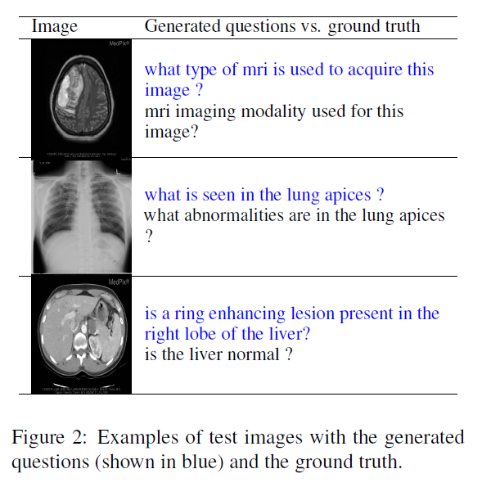
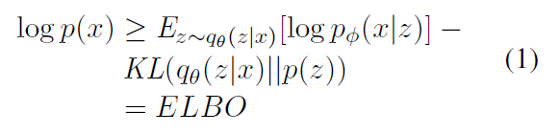
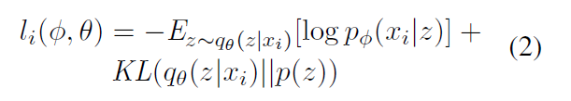



3 . Methods . . . .
3.1. Data Augmentation:-
3.2 . Visual Question Generation

Slide 6
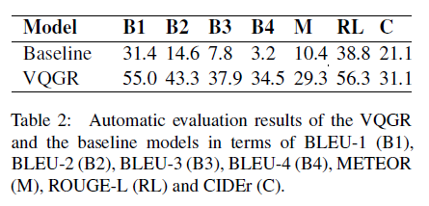
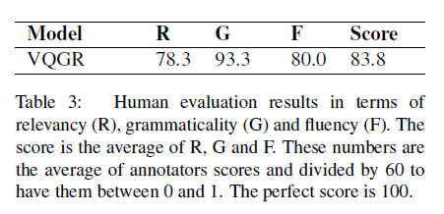
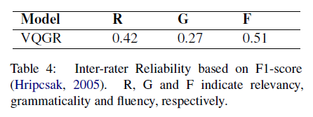
4 . Experimental Results
4.1 Dataset-
used the VQA-RAD dataset of clinical visual questions and images. It contains 315 images and 3,515 corresponding
particularly interested in questions about ‘Modality”, “Abnormality”, “Organ”, and “Plane”.
4.2 Evaluation Metrics-perform both automatic and manual evaluations.
4.2.1 Automatic evaluation - Used a variety of language modeling evaluation metrics such as BLEU, ROUGE, METEOR, and CIDEr.
4.2.2 Human evaluation -Manually checked the generated questions and rated them in terms of relevancy, grammaticality, and fluency.
4.3 Implementation Details- used ImageNet-pretrained ResNet-50 provided by PyTorch as the image encoder and do not fine-tune its weights. LSTM decoder is used for generating questions.
4.4 Results and Discussion -

Slide 7
5 . Conclusion and Future Work
A data augmentation method to generate new training questions and images from the VQA-RAD dataset.
Introduced the VQGR model that generates questions from radiology images.
In the future, we will investigate the use of the generated questions to advance VQA in the medical domain.

